Slide 1

Get Rich Quick!
Using Boost.Beast WebSockets and Networking TS
Vinnie Falco
Author of Boost.Beast
CppCon 2018
Sep 23-29

Slide 2
visit cpp.al

Slide 3
Boost.Beast
HTTP and WebSocket protocols
Using Boost.Asio
Header-only C++11
Part of Boost 1.66.0 and later
Goal: Standardization
https://github.com/boostorg/beast

Slide 4
Boost C++ Libraries
Best permissive license
Review process breeds excellence
Establish existing practice
Become part of C++
boost::shared_ptr | boost::asio
boost::optional | boost::filesystem
boost::bind | boost::thread
boost::mutex | boost::shared_mutex
boost::chrono | boost::function
BOOST_FOR_EACH | BOOST_STATIC_ASSERT

Slide 5
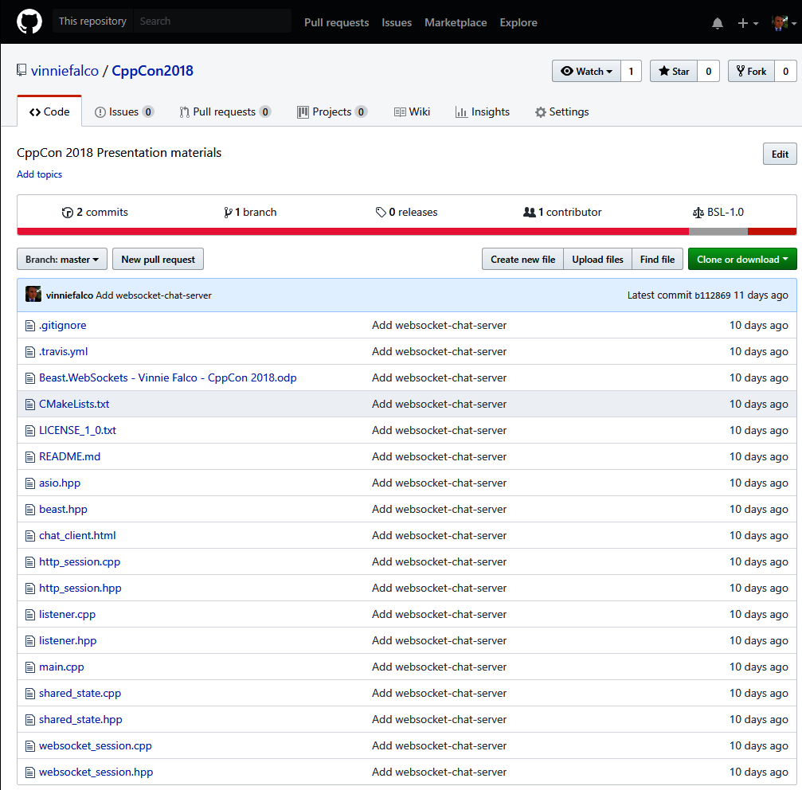
Repository
https://github.com/vinniefalco/CppCon2018

Slide 6


Slide 7


http://agar.io
http://slither.io

Slide 8
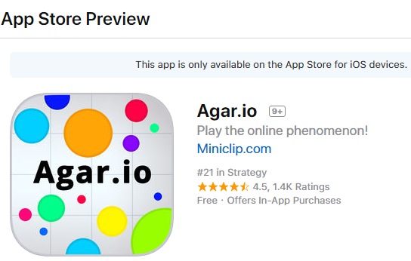
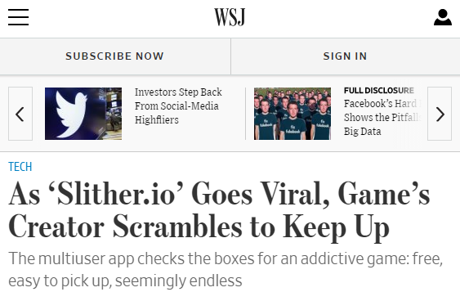
http://agar.io
http://slither.io
Written by Matheus Valdares
Released in 2015 on 4chan
Free to play, runs in browser
Multiplayer online battle arena
500 players per instance
Peak $100,000 daily ad income
Number 1 mobile game
Written by Steven Howse
Self-published in 2016
Free to play, runs in browser
Multiplayer online battle arena
600 players per instance
Peak $100,000 daily ad income
HTML5 graphics

Slide 9


Recipe
C++ WebSocket Server
Browser WebSocket Client

Slide 10

Contents
Protocols
Networking TS
Chat Server
Chat Client
Epilogue

Slide 11

Protocols

Slide 12








HTTP
“Hypertext Transfer Protocol”
Client
Server
DNS
192.168.17.42
TCP/IP

Slide 13
HTTP
Half-Duplex
Client
Server
HTTP Request
HTTP Response

Slide 14
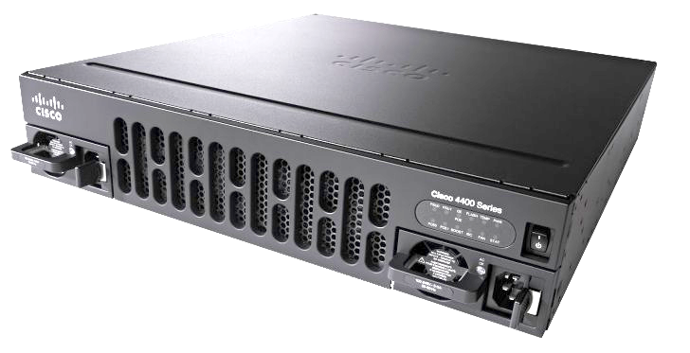
HTTP
Transportable by proxies and firewalls
Client
Proxy
Server

Slide 15
WebSocket
RFC6455 (hybi-17)
Symmetric, full-duplex
Transportable by proxies and firewalls
Message oriented, length-prefixed frames
Single-frame
message
Multi-frame
message
Control frame:
close, ping, pong
header
header
header
header
header
...
payload
payload
payload
payload
payload
127 byte max

Slide 16
WebSocket
Client
Server
HTTP Upgrade Request
TARGET
GET /chat.cgi HTTP/1.1
Host: www.example.org
Upgrade: websocket
Connection: upgrade
Sec-WebSocket-Key: 2pGeTR08MA==
Sec-WebSocket-Version: 13
User-Agent: Beast

Slide 17
WebSocket
Client
Server
HTTP Upgrade Response
HTTP/1.1 101 Switching Protocols
Upgrade: websocket
Connection: upgrade
Sec-WebSocket-Accept: shZRK+xOo=
Server: Beast

Slide 18
API Layers
Application
Beast WebSockets
Beast HTTP
Networking TS
Operating System

Slide 19
Networking TS

Slide 20
Flavors
Library | Header file location and namespace
Networking TS | <experimental/io_context> std::experimental::net::io_context
Boost.Asio | <boost/asio/io_context.hpp> boost::asio::io_context
Asio | <asio/io_context.hpp> asio::io_context

Slide 21
Basics
// Required for ALL I/O activities
net::io_context ioc;
// Declare a TCP/IP socket
net::ip::tcp::socket sock(ioc);
...
// Write some data
auto bytes_transferred = sock.write_some(b);

Slide 22
Basics
// Required for ALL I/O activities
net::io_context ioc;
// Declare a TCP/IP socket
net::ip::tcp::socket sock(ioc);
...
// Write some data
auto bytes_transferred = net::write(sock, b);

Slide 23
Basics
// Required for ALL I/O activities
net::io_context ioc;
// Declare a TCP/IP socket
net::ip::tcp::socket sock(ioc);
...
// Write some data
auto bytes_transferred = net::write(sock, b);

Slide 24

Basics
// Required for ALL I/O activities
net::io_context ioc;
// Declare a TCP/IP socket
net::ip::tcp::socket sock(ioc);
...
// Write some data
auto bytes_transferred = net::write(sock, b);

Slide 25
Buffers
class mutable_buffer
{
...
public:
mutable_buffer();
mutable_buffer(
void*, size_t);
size_t size();
void* data();
};
class const_buffer
{
...
public:
const_buffer();
const_buffer(
void const*, size_t);
const_buffer(
mutable_buffer);
size_t size();
void const* data();
};

Slide 26
Buffers
// Send a payload prefixed with a header
template<class SyncWriteStream>
void
send_message(
SyncWriteStream& stream,
net::const_buffer payload);
message:
header
payload

Slide 27
Buffers
// Send a payload prefixed with a header
template<class SyncWriteStream>
void
send_message(
SyncWriteStream& stream,
net::const_buffer payload)
{
net::write(stream, make_header(payload));
net::write(stream, payload);
}

Slide 28

Buffers
// Send a payload prefixed with a header
template<class SyncWriteStream>
void
send_message(
SyncWriteStream& stream,
net::const_buffer payload)
{
net::write(stream, make_header(payload));
net::write(stream, payload);
}
System I/O calls, such as socket reads and writes, are usually incredibly expensive.

Slide 29
Buffers
// Send a payload prefixed with a header
template<class SyncWriteStream>
void
send_message(
SyncWriteStream& stream,
net::const_buffer payload)
{
auto header = make_header(payload)
// Create a non-owning, 2-element buffer range
std::array<2,
net::const_buffer> b{header, payload};
net::write(stream, b);
}

Slide 30
Buffer Sequence
// Write a buffer sequence to a stream
// Returns: The number of bytes written
template<
class SyncWriteStream,
class ConstBufferSequence>
size_t
write(
SyncWriteStream& stream,
ConstBufferSequence const& b);

Slide 31
Buffer Sequence
Bidirectional range of contiguous memory regions
Reference semantics (no ownership)
Length is fixed and cannot be resized
Lightweight and copyable (don’t use vector!)
Networking TS concept, user-defined types possible
Beast provides several buffer sequence types

Slide 32
ConstBufferSequence
A ConstBufferSequence is a non-owning range of read-only memory regions.
In this table:
- X is a type meeting the requirements of ConstBufferSequence
- a is a value of type X
Expression | Type | Description
X::value_type | T | T is convertible to const_buffer.
X::const_iterator | U | U is a bidirectional iterator whose reference type is convertible to const_buffer.
X(a) | X | X is CopyConstructible. The copy will reference the same memory regions as the original sequence.
a.begin(); a.end(); | const_iterator or convertible to const_iterator
const_buffer mutable_buffer |  | Also a ConstBufferSequence.

Slide 33
MutableBufferSequence
A MutableBufferSequence is a non-owning range of mutable memory regions.
In this table:
- X is a type meeting the requirements of MutableBufferSequence
- a is a value of type X
Expression | Type | Description
X::value_type | T | T is convertible to mutable_buffer.
X::const_iterator | U | U is a bidirectional iterator whose reference type is convertible to mutable_buffer.
X(a) | X | X is CopyConstructible. The copy will reference the same memory regions as the original sequence.
a.begin(); a.end(); | const_iterator or convertible to const_iterator
mutable_buffer |  | Also a MutableBufferSequence.

Slide 34
Buffers
string s = “Hello, world!”;
net::write(sock,
net::const_buffer(s.data(), s.size()));
// Better
net::write(sock, net::buffer(s));

Slide 35
Buffers
string s = “Hello, world!”;
net::write(sock,
net::const_buffer(s.data(), s.size()));
// Better
net::write(sock, net::buffer(s));

Slide 36
Buffers
template<typename PodType, size_t N>
mutable_buffer buffer(array<PodType, N>& data);
template<typename PodType, size_t N>
const_buffer buffer(array<PodType, N> const& data);
template<typename PodType, typename Allocator>
mutable_buffer buffer(vector<PodType, Allocator>& data);
template<typename PodType, typename Allocator>
const_buffer buffer(vector<PodType, Allocator> const& data);
template<typename Elem, typename Traits, typename Allocator>
mutable_buffer buffer(basic_string<Elem, Traits, Allocator>& data);
template<typename Elem, typename Traits, typename Allocator>
const_buffer buffer(basic_string<Elem, Traits, Allocator> const& data);
// ...26 more overloads

Slide 37
Buffers
// Read data into a buffer until
// it contains a specified string
auto matching_bytes =
net::read_until(sock, b, “\r\n\r\n”);

Slide 38
Buffers
// Read data into a buffer until
// it contains a specified string
auto matching_bytes =
net::read_until(sock, b, “\r\n\r\n”);

Slide 39
Buffers
// Read data into a buffer until
// it contains a specified string
auto matching_bytes =
net::read_until(sock, b, “\r\n\r\n”);
template<
class SyncReadStream,
class DynamicBuffer>
size_t
read_until(
SyncReadStream& s,
DynamicBuffer&& buffer,
string_view match);

Slide 40
DynamicBuffer
A resizable buffer sequence with a read area and a write area
Useful when the expected input size is unknown
Networking TS concept, user-defined types possible
Beast provides several dynamic buffer types
read area
ConstBufferSequence
write area
MutableBufferSequence

Slide 41
DynamicBuffer
// X is a type meeting the requirements of DynamicBuffer
X a;
read area
0 bytes
write area
0 bytes

Slide 42
DynamicBuffer
X a;
// Resize the write area and read into it
auto bytes_transferred = sock.read_some(a.prepare(128));
read area
0 bytes
write area
128 bytes

Slide 43
DynamicBuffer
X a;
auto bytes_transferred = sock.read_some(a.prepare(128));
// Move bytes from the write area to the read area
a.commit(bytes_transferred);
read area
60 bytes
write area
0 bytes

Slide 44
DynamicBuffer
X a;
auto bytes_transferred = sock.read_some(a.prepare(128));
a.commit(bytes_transferred);
// Process data in the read area
auto bytes_used = process(a.data());
read area
20 bytes
write area
0 bytes

Slide 45
DynamicBuffer
X a;
auto bytes_transferred = sock.read_some(a.prepare(128));
a.commit(bytes_transferred);
auto bytes_used = process(a.data());
// Remove bytes from the read area
a.consume(bytes_used);
read area
20 bytes
write area
0 bytes

Slide 46
DynamicBuffer
class DynamicBuffer
{
public:
using const_buffers_type = ...; // The type representing the read area
using mutable_buffers_type = ...; // The type representing the write area
size_t size() const; // Returns the size of the read area
size_t max_size() const; // Returns maximum sum of read and write area sizes
size_t capacity() const; // Returns maximum sum of sizes without reallocating
// Returns the read area as a ConstBufferSequence
const_buffers_type data() const;
// Resize the write area and return it as a MutableBufferSequence
mutable_buffers_type prepare(size_t size);
// Move bytes from beginning of write area to end of read area
void commit(size_t size);
// Remove bytes from beginning of read area
void consume(size_t size);
};

Slide 47
Asynchronous I/O
// Perform a blocking read
auto bytes_transferred = sock.read_some(b);
// Start a non-blocking read
// this call returns immediately
sock.async_read_some(buffers, handler);

Slide 48
Asynchronous I/O
// Perform a blocking read
auto bytes_transferred = sock.read_some(b);
// Start a non-blocking read
// this call returns immediately
sock.async_read_some(buffers, handler);

Slide 49
Asynchronous I/O
// Perform a blocking read
auto bytes_transferred = sock.read_some(b);
// Start a non-blocking read
// this call returns immediately
sock.async_read_some(buffers, handler);

Slide 50
Asynchronous I/O
// Perform a blocking read
auto bytes_transferred = sock.read_some(b);
// Start a non-blocking read,
// this call returns immediately
sock.async_read_some(buffers,
[&](error_code ec,
size_t bytes_transferred)
{
// Called later when the read is complete
...
});

Slide 51
Completion Handler
An invocable function object with the right signature
Requires MoveConstructible
Networking TS concept for user-defined types
// Lambda expression
[](error_code, size_t){}
// User-defined function object
struct my_handler
{
void operator()(error_code, size_t);
};
// A call wrapper
bind(&connection::on_read, this, _1, _2); // gasp!

Slide 52
Asynchronous I/O
// Start a non-blocking read,
// this call returns immediately
sock.async_read_some(buffers,
[&](error_code ec,
size_t bytes_transferred)
{
// Called when the read is complete
...
});
// Execution continues here while the
// read operation is “outstanding” (a TS term).

Slide 53
Asynchronous I/O
// Start a non-blocking read,
// this call returns immediately
sock.async_read_some(buffers,
[&](error_code ec,
size_t bytes_transferred)
{
// Called when the read is complete
...
});

Slide 54

Asynchronous I/O
// Start a non-blocking read,
// this call returns immediately
sock.async_read_some(buffers,
[&](error_code ec,
size_t bytes_transferred)
{
// Called when the read is complete
...
});

Slide 55

Asynchronous I/O
Basic guarantee
Completion handlers will only be called from threads that are currently calling io_context::run().

Slide 56
io_context::run
// I/O context uses the current thread
ioc.run();
// I/O context uses a newly created thread
thread([&ioc]{ ioc.run(); });

Slide 57
io_context::run
// I/O context uses the current thread
ioc.run();
// I/O context uses a newly created thread
thread([&ioc]{ ioc.run(); });

Slide 58
io_context::run
// I/O context uses the current thread
ioc.run();
// I/O context uses a newly created thread
thread([&ioc]{ ioc.run(); }).detach();

Slide 59
io_context::run
// I/O context uses the current thread
ioc.run();
// I/O context uses a newly created thread
thread([&ioc]{ ioc.run(); }).detach();
// I/O context uses a group of N threads
assert(N > 0);
vector<thread> v;
v.reserve(N - 1);
while(N--)
v.emplace_back([&ioc]{ ioc.run(); });
ioc.run();

Slide 60
io_context::run
// I/O context uses the current thread
ioc.run();
// I/O context uses a newly created thread
thread([&ioc]{ ioc.run(); }).detach();
// I/O context uses a group of N threads
assert(N > 0);
vector<thread> v;
v.reserve(N - 1);
while(N--)
v.emplace_back([&ioc]{ ioc.run(); });
ioc.run(); // ...including the current thread!

Slide 61
io_context::run
User determines synchronization:
  Single-threaded
  Multi-threaded
  Stranded
User-controlled
  Catch exceptions
  Do thread-specific init (e.g. CoInitializeEx)
Thread-agnostic
  std::thread
  boost::thread
  Platforms with no threads

Slide 62
Multi-threading
An executor embodies a set of rules about where, when and how to run a function object.
Networking TS can use an executor to run a completion handler
A strand provides an additional execution guarantee:
  Completion handlers invoked through a given strand’s executor will never run concurrently
Single-threaded io_context is an “implicit strand”:
  Completion handlers can never run concurrently
Multi-threaded programs are hard to write, hard to reason about, and hard to maintain.

Slide 63
Threading Models
Type | Features | Notes
single threaded, single io_context | Fastest Limited capacity Implicit strand | Easiest to write
multi-threaded, single io_context | Highest capacity Explicit strand | More capacity, but more overhead
multi-threaded, io_context per thread | Fastest Highest capacity Implicit strand Needs balancing | Most complex

Slide 64
Chat Server

Slide 65
Chat Server
// Boost/Asio
namespace net = boost::asio;
using tcp = net::ip::tcp;
using error_code = boost::system::error_code;
// Beast
namespace beast = boost::beast;
namespace http = boost::beast::http;
namespace websocket = boost::beast::websocket;

Slide 66
Chat Server
// Creates and runs the server
int main(int argc, char* argv[]);
// Holds the server data
class shared_state;
// Accepts incoming connections
class listener;
// Handles HTTP requests on a connection
class http_session;
// Maintains an active WebSocket session
class websocket_session;

Slide 67
Chat Server
class shared_state
{
std::string doc_root_;
std::unordered_set<websocket_session*> sessions_;
public:
explicit
shared_state(std::string doc_root);
std::string const&
doc_root() const noexcept { return doc_root_; }
void join (websocket_session& session);
void leave (websocket_session& session);
void send (std::string message);
};

Slide 68
Chat Server
void shared_state::join(websocket_session& session)
{
sessions_.insert(&session);
}
void shared_state::leave(websocket_session& session)
{
sessions_.erase(&session);
}
void shared_state::send(std::string message)
{
auto const ss = std::make_shared<
std::string const>(std::move(message));
for(auto session : sessions_)
session->send(ss);
}

Slide 69
Chat Server
int main(int argc, char* argv[])
{
// Usage:
// websocket-chat-server <address> <port> <doc_root>
auto address =
net::ip::make_address(argv[1]);
auto port =
static_cast<unsigned short>(std::atoi(argv[2]));
auto doc_root = argv[3];
...

Slide 70
Chat Server
int main(int argc, char* argv[])
...
// The io_context is required for all I/O
net::io_context ioc;
// Create and launch a listening port
std::make_shared<listener>(
ioc,
tcp::endpoint{address, port},
std::make_shared<shared_state>(doc_root)
)->run();
ioc.run();
return EXIT_SUCCESS;
}

Slide 71
Chat Server
class listener
: public std::enable_shared_from_this<listener>
{
tcp::acceptor acceptor_;
tcp::socket socket_;
std::shared_ptr<shared_state> state_;
void fail(error_code ec, char const* what);
void on_accept(error_code ec);
public:
listener(
net::io_context& ioc,
tcp::endpoint endpoint,
std::shared_ptr<shared_state> const& state);
void run();
};

Slide 72
Chat Server
void listener::run()
{
// Start accepting a connection.
acceptor_.async_accept(
socket_,
[self = shared_from_this()](error_code ec)
{
self->on_accept(ec);
});
}

Slide 73
Chat Server
void listener::on_accept(error_code ec)
{
if(ec)
fail(ec, "accept");
else
// Launch a new session for this connection
std::make_shared<http_session>(
std::move(socket_), state_)->run();
// Accept another connection
acceptor_.async_accept(
socket_,
[self = shared_from_this()](error_code ec)
{
self->on_accept(ec);
});
}

Slide 74
Chat Server
void listener::fail(
error_code ec, char const* what)
{
// Don't report on canceled operations
if(ec == net::error::operation_aborted)
return;
std::cerr <<
what << ": " <<
ec.message() << "\n";
}

Slide 75
Chat Server
class http_session
: public std::enable_shared_from_this<http_session>
{
tcp::socket socket_;
beast::flat_buffer buffer_;
std::shared_ptr<shared_state> state_;
http::request<http::string_body> req_;
void fail(error_code ec, char const* what);
void on_read(error_code ec, std::size_t);
void on_write(error_code ec, std::size_t, bool close);
public:
http_session(tcp::socket socket,
std::shared_ptr<shared_state> const& state);
void run();
};

Slide 76
Chat Server
http_session::http_session(
tcp::socket socket,
std::shared_ptr<shared_state> const& state)
: socket_(std::move(socket))
, state_(state)
{
}
void http_session::run()
{
// Read a request
http::async_read(socket_, buffer_, req_,
[self = shared_from_this()]
(error_code ec, std::size_t bytes)
{
self->on_read(ec, bytes);
});
}

Slide 77
Chat Server
void http_session::on_read(error_code ec, std::size_t)
{
// This means they closed the connection
if(ec == http::error::end_of_stream)
{
socket_.shutdown(tcp::socket::shutdown_send, ec);
return;
}
if(ec)
return fail(ec, "read");
// Handle WebSocket Upgrade
if(websocket::is_upgrade(req_))
{
// Create a WebSocket session by transferring the socket
std::make_shared<websocket_session>(
std::move(socket_), state_)->run(std::move(req_));
return;
}
...

Slide 78
Chat Server
void http_session::on_read(error_code ec, std::size_t)
...
handle_request(state_->doc_root(), std::move(req_),
[this](auto&& response)
{
using response_type = typename
std::decay<decltype(response)>::type;
auto sp = std::make_shared<response_type>(
std::move(response));
http::async_write(this->socket_, *sp,
[self = shared_from_this(), sp](
error_code ec, std::size_t bytes)
{
self->on_write(ec, bytes, sp->need_eof());
});
});
}

Slide 79
Chat Server
void http_session::on_write(
error_code ec, std::size_t, bool close)
{
if(ec)
return fail(ec, "write");
if(close)
{
// This means we should close the connection,
socket_.shutdown(tcp::socket::shutdown_send, ec);
return;
}
// Clear contents of the request message,
// otherwise the read behavior is undefined.
req_ = {};
// Read another request
http::async_read(socket_, buffer_, req_,
[self = shared_from_this()]
(error_code ec, std::size_t bytes)
{
self->on_read(ec, bytes);
});
}

Slide 80
Chat Server
class websocket_session
: public std::enable_shared_from_this<websocket_session>
{
beast::flat_buffer buffer_;
websocket::stream<tcp::socket> ws_;
std::shared_ptr<shared_state> state_;
std::vector<std::shared_ptr<std::string const>> queue_;
void fail(error_code ec, char const* what);
void on_accept(error_code ec);
void on_read(error_code ec, std::size_t);
void on_write(error_code ec, std::size_t);
public:
~websocket_session();
websocket_session(tcp::socket socket,
std::shared_ptr<shared_state> const& state);
template<class Body, class Allocator>
void run(http::request<Body, http::basic_fields<Allocator>> req);
void send(std::shared_ptr<std::string const> const& ss);
};

Slide 81
Chat Server
template<class Body, class Allocator>
void websocket_session::
run(
http::request<Body, http::basic_fields<Allocator>> req)
{
// Accept the websocket handshake
ws_.async_accept(req,
[self = shared_from_this()](error_code ec)
{
self->on_accept(ec);
});
}

Slide 82
Chat Server
void websocket_session::
on_accept(error_code ec)
{
if(ec)
return fail(ec, "accept");
// Add this session to the list
state_->join(*this);
// Read a message
ws_.async_read(
buffer_,
[sp = shared_from_this()](
error_code ec, std::size_t bytes)
{
sp->on_read(ec, bytes);
});
}

Slide 83
Chat Server
void websocket_session::
on_read(error_code ec, std::size_t)
{
if(ec)
return fail(ec, "read");
// Send to all connections
state_->send(
beast::buffers_to_string(buffer_.data()));
// Clear the buffer
buffer_.consume(buffer_.size());
ws_.async_read(buffer_, [sp = shared_from_this()](
error_code ec, std::size_t bytes)
{
sp->on_read(ec, bytes);
});
}

Slide 84
Chat Server
void websocket_session::
send(std::shared_ptr<std::string const> const& ss)
{
// Always add to queue
queue_.push_back(ss);
// Are we already writing?
if(queue_.size() > 1)
return;
ws_.async_write(
net::buffer(*queue_.front()),
[sp = shared_from_this()](
error_code ec, std::size_t bytes)
{
sp->on_write(ec, bytes);
});
}

Slide 85
Chat Server
void websocket_session::
on_write(error_code ec, std::size_t)
{
if(ec)
return fail(ec, "write");
queue_.erase(queue_.begin());
if(! queue_.empty())
ws_.async_write(
net::buffer(*queue_.front()),
[sp = shared_from_this()](
error_code ec, std::size_t bytes)
{
sp->on_write(ec, bytes);
});
}

Slide 86
Chat Server
void
websocket_session::
fail(error_code ec, char const* what)
{
// Don't report these
if(ec == net::error::operation_aborted ||
ec == websocket::error::closed)
return;
std::cerr << what << ": " <<
ec.message() << "\n";
}

Slide 87
Chat Server
websocket_session::
~websocket_session()
{
state_->leave(*this);
}

Slide 88
Chat Client

Slide 89
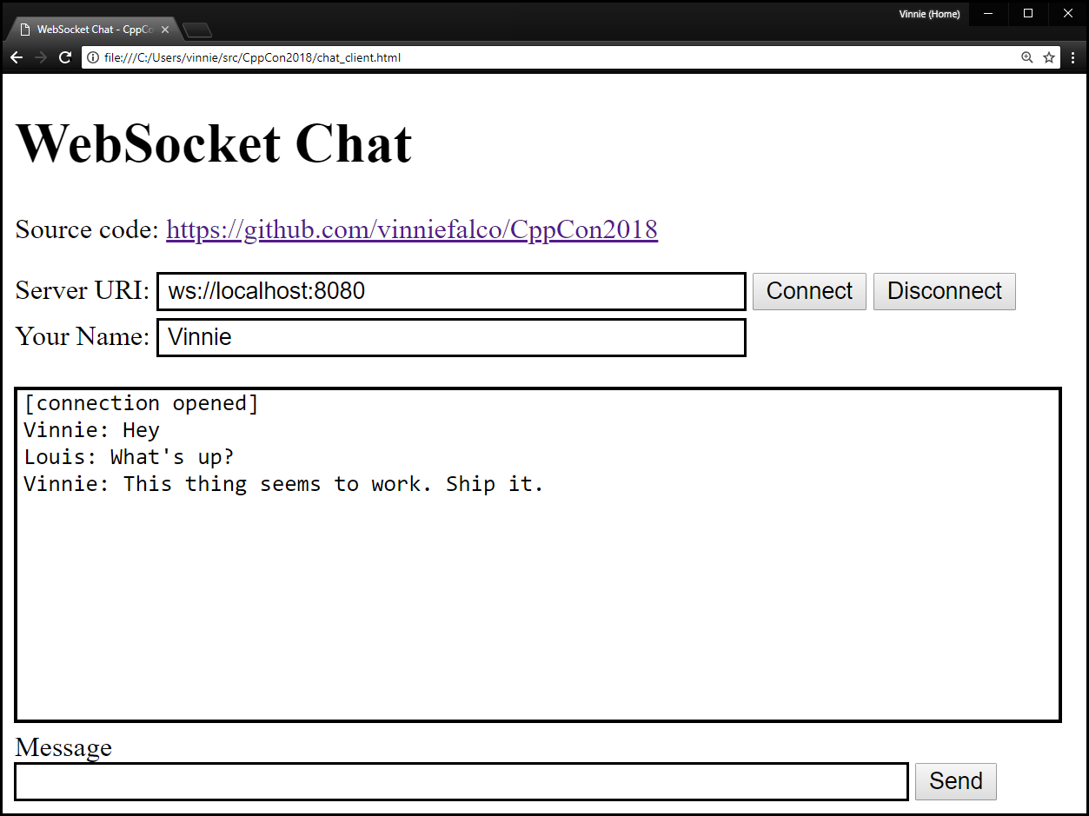
Chat Client

Slide 90
Chat Client
<html>
<head>
<title>WebSocket Chat – CppCon2018</title>
</head>
<body>
<h1>WebSocket Chat</h1>
<!-- UI and app -->
</body>
</html>

Slide 91
Chat Client
Server URI:
<input
id="uri"
size="47"
class="draw-border"
style="margin-bottom: 5px;"
value="ws://localhost:8080">

Slide 92

Chat Client
<button
id="connect"
class="echo-button">
Connect
</button>
<button
id="disconnect"
class="echo-button">
Disconnect
</button>

Slide 93
Chat Client
Your Name:
<input
id="userName"
class="draw-border"
size=47>

Slide 94
Chat Client
<pre
id="messages"
style=”border: solid 1px #cccccc;">
</pre>

Slide 95

Chat Client
Message<br>
<input
id="sendMessage"
class="draw-border">
<button
id="send"
class="echo-button">Send</button>

Slide 96


Slide 97

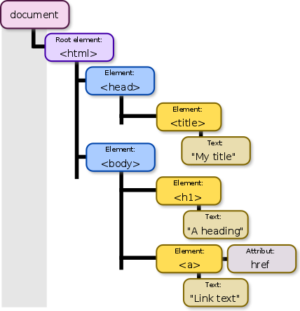
DOM
Document Object Model
DOM
Document Object Model

Slide 98

DANGER!

Slide 99
DANGER!
JavaScript ahead!

Slide 100
Chat Client
<script>
var ws = null;
connect.onclick = function() {
ws = new WebSocket(uri.value);
...
};
</script>
id="uri" id="connect"

Slide 101
Chat Client
connect.onclick = function() {
...
ws.onopen = function(ev) {
messages.innerText +=
"[connection opened]\n";
};
ws.onclose = function(ev) {
messages.innerText +=
"[connection closed]\n";
};

Slide 102
Chat Client
connect.onclick = function() {
...
ws.onmessage = function(ev) {
messages.innerText += ev.data + "\n";
};
ws.onerror = function(ev) {
messages.innerText += "[error]\n";
console.log(ev);
};
};

Slide 103
Chat Client
...
disconnect.onclick = function() {
ws.close();
};
id="disconnect"

Slide 104
Chat Client
...
send.onclick = function() {
ws.send(userName.value +
": " + sendMessage.value);
sendMessage.value = "";
};
id=”sendMessage” id="send"

Slide 105
Chat Client
...
sendMessage.onkeyup = function(ev) {
ev.preventDefault();
if (event.keyCode === 13) {
send.click();
};
};
</script>
id=”sendMessage” id="send"

Slide 106
Chat Client
<!DOCTYPE html><html>
<head><meta charset="utf-8" /><title>WebSocket Chat – CppCon2018</title></head>
<body><h1>WebSocket Chat</h1><p>Source code:
<a href="https://github.com/vinniefalco/CppCon2018">https://github.com/vinniefalco/CppCon2018</a></p>
Server URI:
<input class="draw-border" id="uri" size="47" value="ws://localhost:8080" style="margin-bottom: 5px;">
<button class="echo-button" id="connect">Connect</button>
<button class="echo-button" id="disconnect">Disconnect</button><br>
Your Name: <input class="draw-border" id="userName" size=47 style="margin-bottom: 5px;"><br>
<pre id="messages"
style="width: 600px; height: 400px; border: solid 1px #cccccc; margin-bottom: 5px;"></pre>
<div style="margin-bottom: 5px;">Message<br>
<input class="draw-border" id="sendMessage" size="74" value="">
<button class="echo-button" id="send">Send</button></div>
<script>
var ws = null;
connect.onclick = function() {
ws = new WebSocket(uri.value);
ws.onopen = function(ev) { messages.innerText += "[connection opened]\n"; };
ws.onclose = function(ev) { messages.innerText += "[connection closed]\n"; };
ws.onmessage = function(ev) { messages.innerText += ev.data + "\n";};
ws.onerror = function(ev) { messages.innerText += "[error]\n"; console.log(ev); };
};
disconnect.onclick = function() { ws.close(); };
send.onclick = function() {
ws.send(userName.value + ": " + sendMessage.value);
sendMessage.value = "";
};
sendMessage.onkeyup = function(ev) {
ev.preventDefault();
if (event.keyCode === 13) {
send.click();
}
}
</script></body></html>

Slide 107
Epilogue

Slide 108


Slide 109
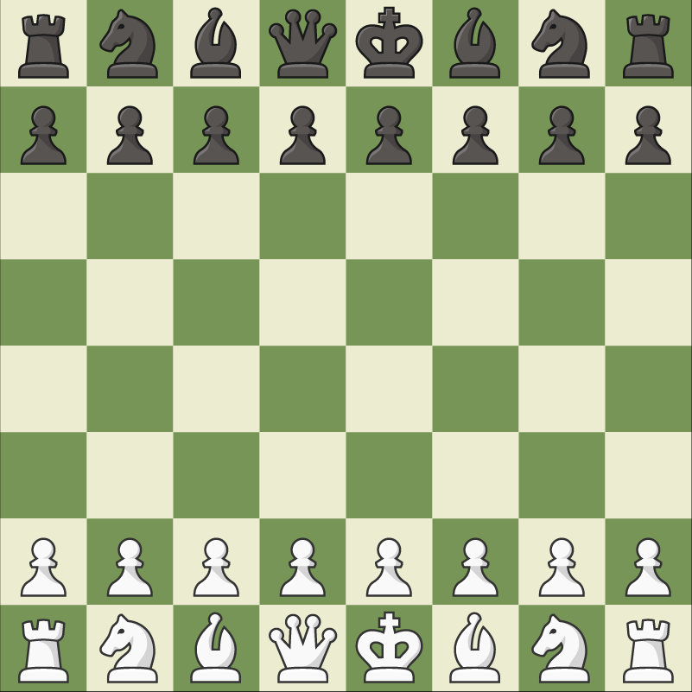
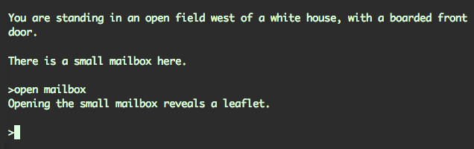
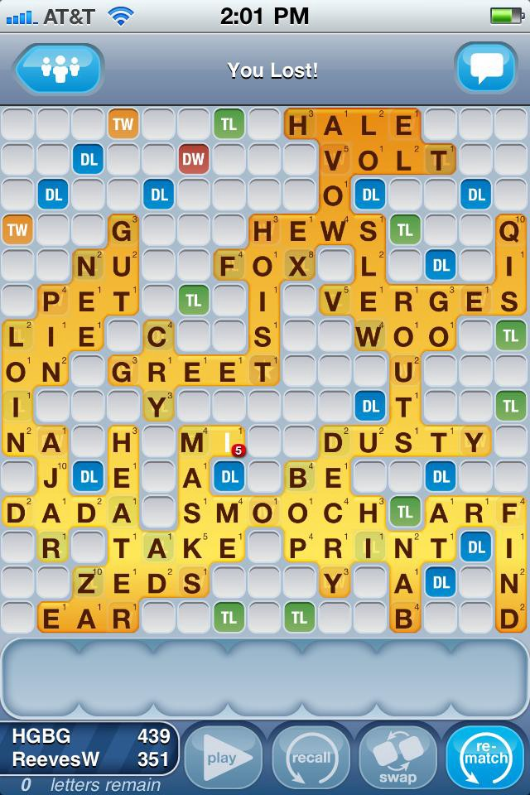

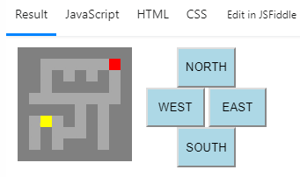
Your App Title Here

Slide 110
Learning Networking
Read the docmentation
Study the examples
Write, write, write!
Ask questions
  Stack Overflow
  Slack / IRC
Find a mentor

Slide 111
Summary
// Code and slides from the talk
https://github.com/vinniefalco/CppCon2018
// Boost.Beast library
https://github.com/boostorg/beast
// Boost libraries, including Asio
https://www.boost.org/doc/libs/

